Slide 1
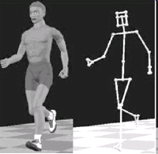
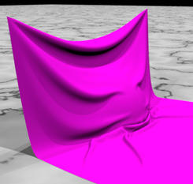
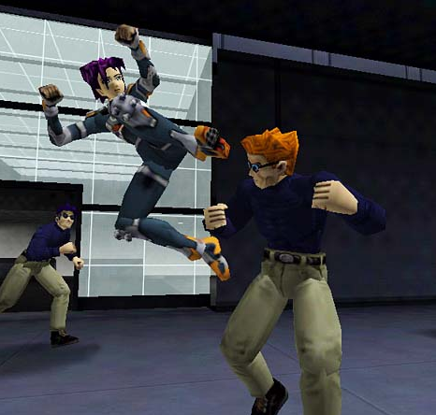
Chapter 6 Summary

Slide 2

Summary
Passive Objects
Active Characters
Simulation
Keyframing
Motion Capture
Performance
based animation
Cloth
Particle
Face
Characters
Fluid
Hair

Slide 3
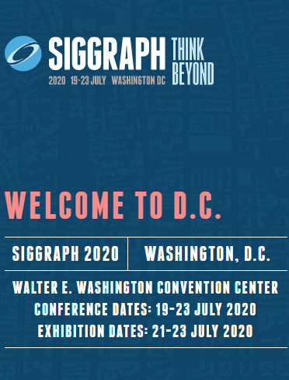
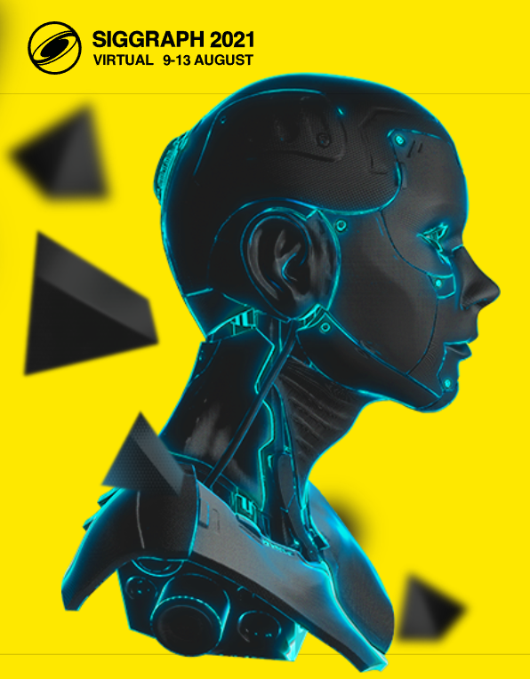
SIGGRAPH
论文集：
https://kesen.realtimerendering.com/sig2021.html
https://kesen.realtimerendering.com/sig2020.html
https://kesen.realtimerendering.com/sig2019.html
https://kesen.realtimerendering.com/sig2018.html

Slide 4
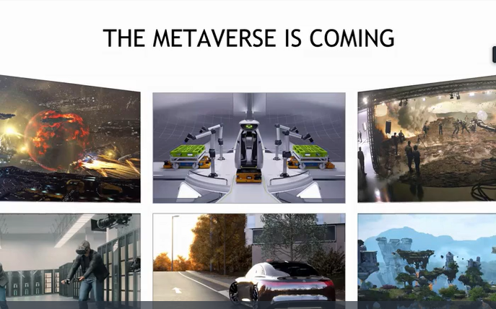
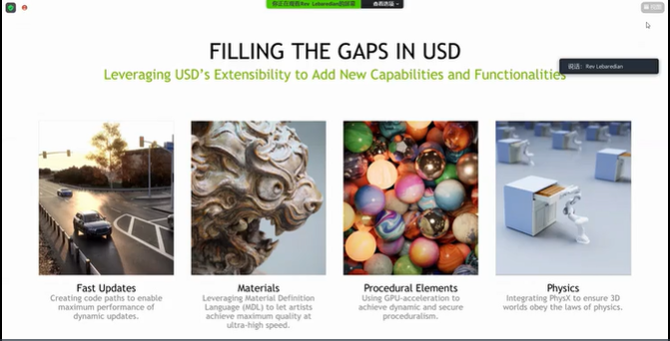
SIGGRAPH——Papers 2021
Notes:
通用场景描述（USD）

Slide 5
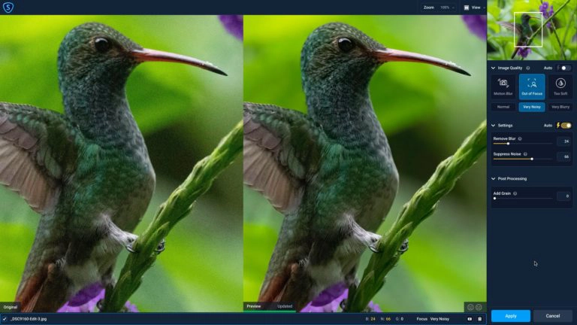
SIGGRAPH——Papers 2021
英伟达展示了 NVIDIA RTX 技术能为 3D 开发者和行业爱好者带来的独家优势
NVIDIA 宣布推出 Omniverse ——全球首个为元宇宙建立的基础模拟平台，让用户身临其境地连接到虚拟世界中，用户在这里可以创建独一无二的数字场景、完美的 3D 模型、设计精美的建筑等

Slide 6
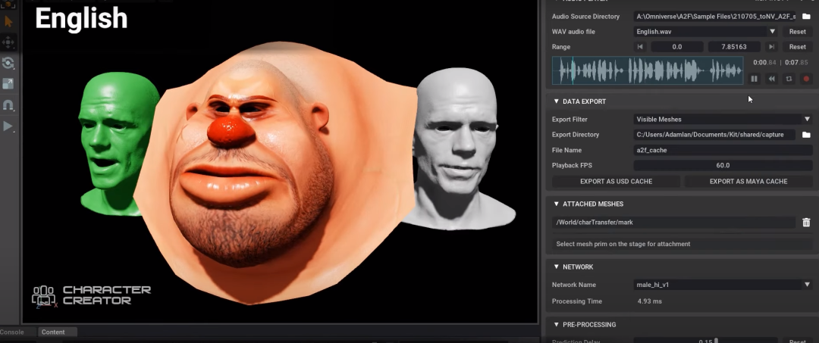
SIGGRAPH——Papers 2021
论文集：https://kesen.realtimerendering.com/sig2021.html
Reallusion Character Creator v3.43 是第一个集成 Audio2Face 的第三方应用程序，允许创作者将角色从 Character Creator 导出到 Omniverse 中使用
面部和唇部动画完全由人工智能驱动，简化了 3D 角色动画的创作过程。

Slide 7
SIGGRAPH——Papers 2021 2020
论文集：https://kesen.realtimerendering.com/sig2021.html
Fluids
Physically Based Simulation
Human Capture and Modeling
论文集：https://kesen.realtimerendering.com/sig2020.html
ANIMATION/SIMULATION
INTERACTION/VR

Slide 8
SIGGRAPH——Papers 2019
论文集：https://kesen.realtimerendering.com/sig2019.html
Fluids I
Fluids II
Animation and Skinning
Motion is in Control
Capture Control
Human Capture and Modeling
Learning to Move
Deformation and FEM

Slide 9
SIGGRAPH——Papers 2018
论文集：https://kesen.realtimerendering.com/sig2018.html
A Race to the Bottom (of the Geometric Energy Plot)
Cloth Encounters of the Shirt Kind
Virtually Human
Interaction/VR
That's Elastic
Fluids 1: Raiders of the Lost Volume
Fluids 2: Vortex Boogaloo
Deep Thoughts on How Things Move
Animation Control
Fabrication for Color and Motion
Portraits & Speech
Bodies in Motion Human Performance Capture

Slide 10
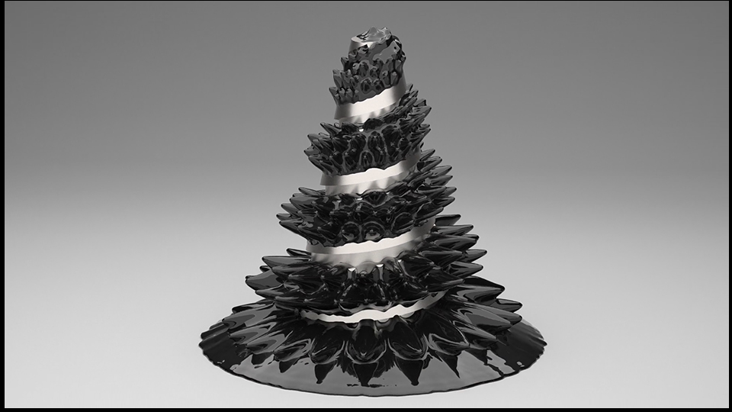
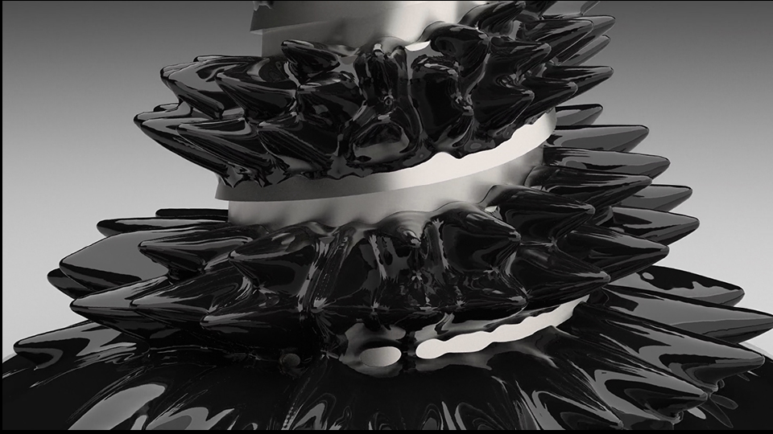
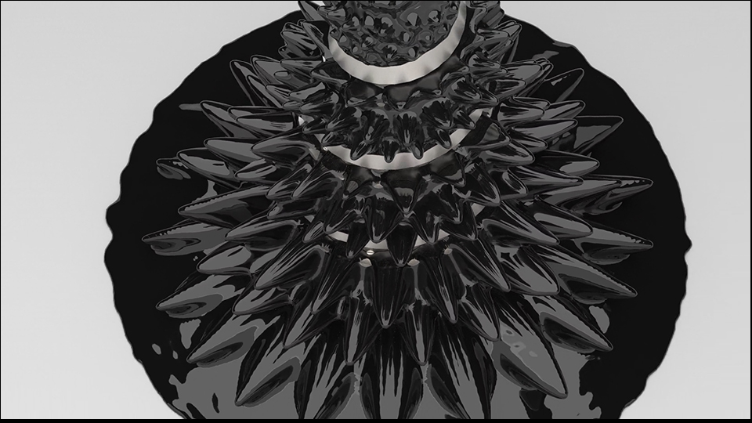
SIGGRAPH——Demo（2019）
On the Accurate Large-scale Simulation of Ferrofluids
http://computationalsciences.org/publications/huang-2019-ferrofluids.html
铁磁流体ferrofluid ：一种在磁场存在时强烈极化的液体，由悬浮于载流体当中纳米数量级的铁磁微粒组成；其载流体通常为有机溶液或水

Slide 11
SIGGRAPH——Demo（2020）
A Level-Set Method for Magnetic Substance Simulation
http://vcl.pku.edu.cn/file/upload_file/image/research/att202005141845/A%20Level-Set%20Method%20for%20Magnetic%20Substance%20Simulation.pdf

Slide 12
SIGGRAPH——Demo（2021）
GPU-Based Simulation of Cloth Wrinkles at Submillimeter Levels
https://web.cse.ohio-state.edu/~wang.3602/Wang-2021-GBS/Wang-2021-GBS.pdf

